Slide 1

BUSINESS ANALYSIS PROJECT 2
FRAUDULENT CREDIT CARDS TRANSACTIONS

Slide 2
PLAN
Team member
Systems Analysis
Result
Alternative Solutions
Assessment of the situation
Recommendations
Appendix

Slide 3

Team Members
Camille JACKYVENS
leamic.cj@gmail.com
David LOUIS
loulludave@gmail.com
Yvesna MARCELIN
yvesnamarcelin48@gmail.com
Moïse MASSON
massonmoise2@gmail.com

Slide 4
Context
The problem that arises is that he customers who have used the credit card to be more secure with their money are having their money stolen. The media on their side helps these people to denounce by accusing the bank of doing nothing to prevent it, they claim that the bank is entirely responsible.

Slide 5
Systems Analysis
The client here is a bank who wishes to provide a better customer service to its customers in order to protect their financial assets.
The problem we are facing here is that the bank's customers are victims of fraudulent credit card transactions.
The customers are losing large amount of money
The environment in which we will do this analysis is the banking sector. In which we have confidential data, which mean using internal data and limited resources.

Slide 6
Stakeholders
The Customers
The customers are really affected by this problem, they lose money that they work hard to get.
Senior Management
This problem affects the bank even more since it can be taken to court, lose its credibility and especially go bankrupt.
Entreprise
They want to have their money stolen back
Electronic product provider
They provide computers, software, security systems and electronic cards.
Media
They are afraid of being stolen and notify people about the risk of being stolen.

Slide 7
What is a way we can measure success or performance in this environment?
Profit margin
Shareholders and Senior managers of the bank mesure their company’s performance by the profit margin.
Total Volume Of Accounts
The total number of accounts managed by your bank mesures their
Client Satisfaction
The bank performance is also measured by customer feedback

Slide 8

Results
Summary of the fraud
Summary Descriptives
Daily trends

Slide 9
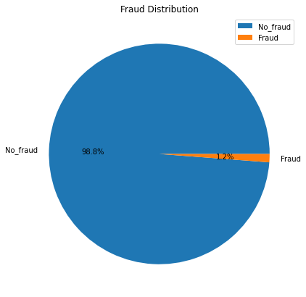
Results
Pie chart of the fraud distribution
We can see that the fraudulent transaction represent a really small part(1.21%) of the overall transaction that did go through the bank.

Slide 10
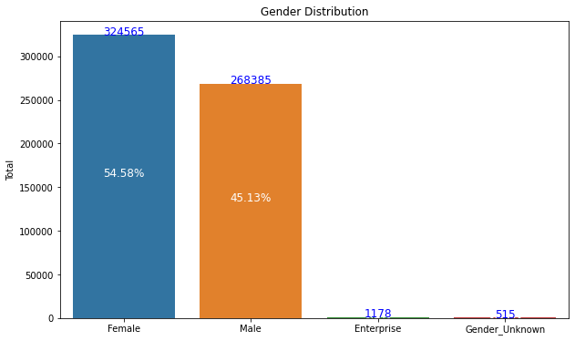
Results
Barchart of the gender distribution
Most of the transaction were made by female (54.58%) and by male (45.13%)

Slide 11
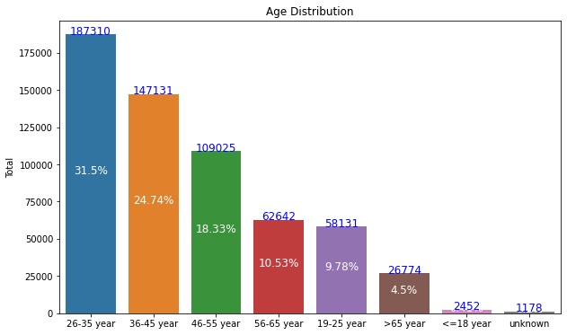
Results
Bar chart of the age distribution
The client of age 26-35 year were the most represented (31.5%) through our database

Slide 12
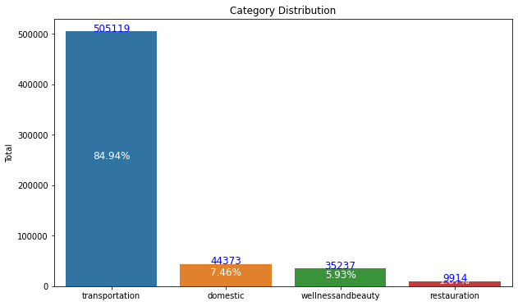
Results
Bar chart of the Category distribution
The most frequent type of transaction made with the credit card was the transportation type(84.94%).

Slide 13
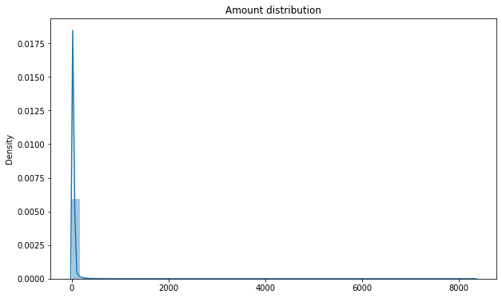
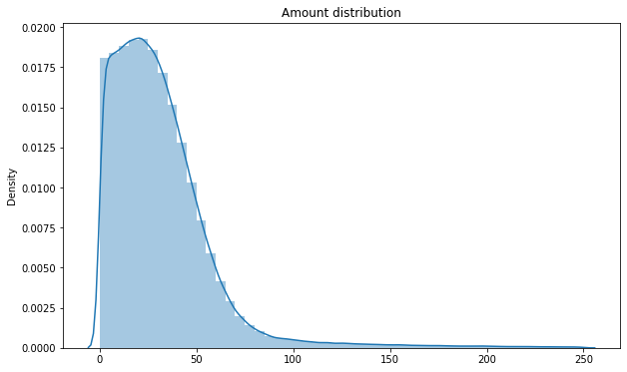
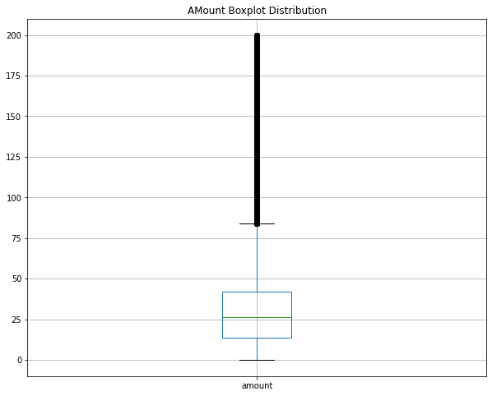
Results
Histogram and bar chart of the amount of money
The most of transaction Had a amount of less than 100$. The average money for a transaction made was 37.89 $, with max of 8329.96 $ and min of 0 $.

Slide 14
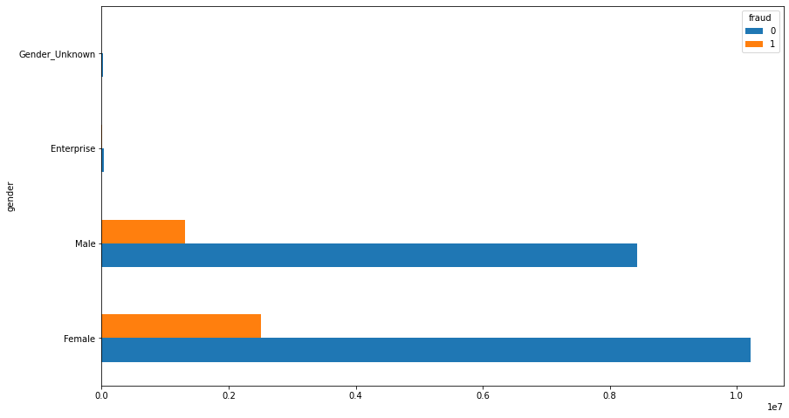
Results
Bar chart of the amount of money by sex stratified the present of fraud
The total amount of fraudulent money was higher for female (2503555.82$) than for male (1315801.14$)

Slide 15
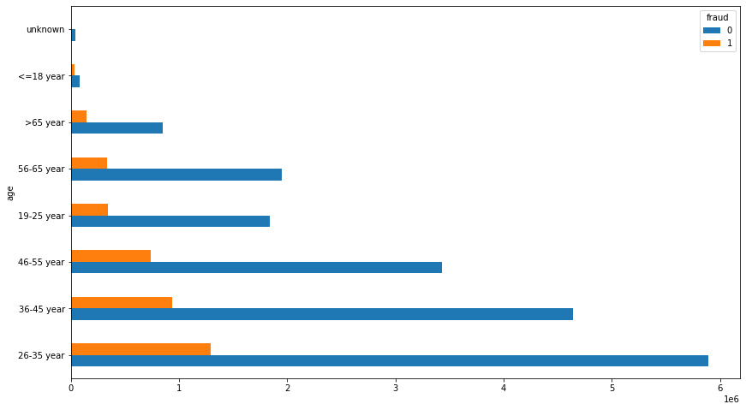
Results
Bar chart of the amount of money by age stratified the present of fraud
The 26-35 year was the age classe with the most amount of fraudulent money.

Slide 16
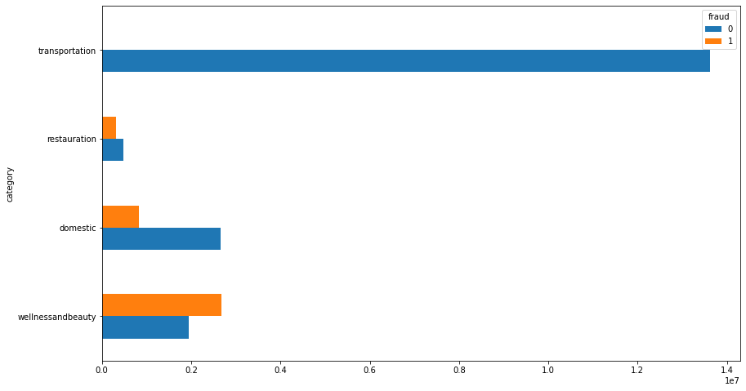
Results
Bar chart of the amount of money by category stratified the present of fraud
In the wellness and beauty category is the one with the most most fraudulent money. Moreover the amount of fraudulent money was higher than the amount of non fraudulent money in this category.
There were no fraud in the transportation transactions.

Slide 17
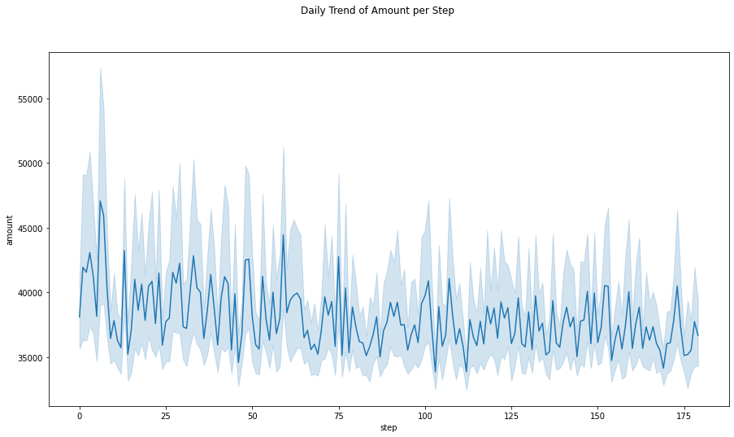
Results
Line chart of the fluctuation of the amount of money per day
This graph shows that the amount of money for each day fluctuate a lot.

Slide 18
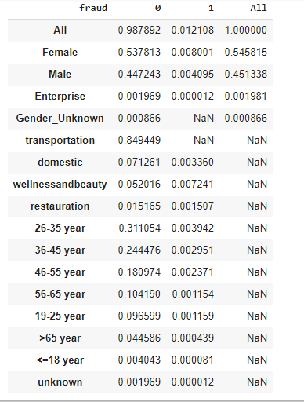

Slide 19

Solutions 1
Detection system
The first solution that should be presented here is using mobile phones as secure transaction systems able to protect customers from fraud.
How
Using a three-level identification system : Customer ID - PIN - Code
The first one could be the customer ID, once entered, sends back a PIN request. The PIN request, Once entered, asks the user for a confirmation code that only himself knows
Benefits
This solution is enough secure
Disadvantages
This solution cost money

Slide 20
Solutions 2
Using bank book
This project identifies the circuit fraudulent transaction, we propose to the bank this following actions :
Exchange credit cards from the age group of 25-36 years with a bankbook : Transactions are validated only when users give two code numbers.
Benefits
This solution cost money
The user loses the bankbook easily
Disadvantages
This solution is not update for young people
This solution cost money

Slide 21
Solutions 3
Regarding to the circuit fraudulent transaction, we propose to the bank this following actions :
The bank should conduct an awareness campaign on the use and security of bank cards among age groups likely to be victims of fraud (25-46), especially among women.
Benefits
This solution will help this group to be aware
Disadvantages
This solution cost money

Slide 22
Recommendations
In general, however, debit and credit card fraud occurs when your card or card information is stolen and used to make unauthorized charges, then the bank can suggest some protectives measures to clients:
Do not share your card details with others ;
By being careful not to share our personal information, it won't fall into the hands of the wrong people. Even sharing with trusted people can be wrong, we have no idea where that information might go ;
Hire a public relations manager
Use only secure websites.
Only make online purchases through trusted websites. That way you won't have to deal with trackers.
Minimize sharing personal information online.
Be more careful in use credit card

Slide 23
References and Appendix
Seaborn

Slide 24
Thanks

